Slide 1
APCA Awareness Day Richardson Event May 13th, 2014

Slide 2
APCA Awareness Day Celebrating Asian Pacific American Heritage Month

Slide 3
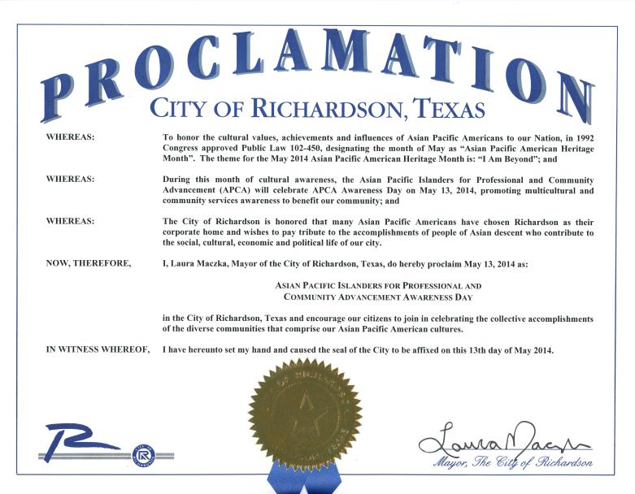
Proclamation from City of Richardson - 2014 APCA Awareness Day

Slide 4
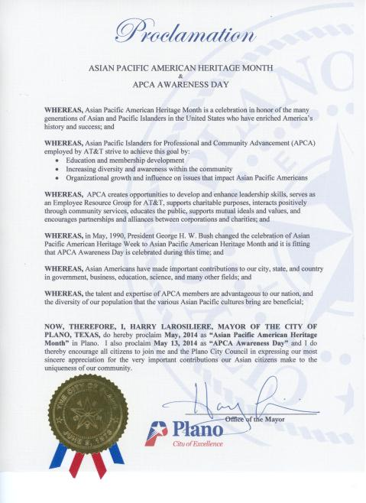
Proclamation from City of Plano for APCA Awareness Day

Slide 5
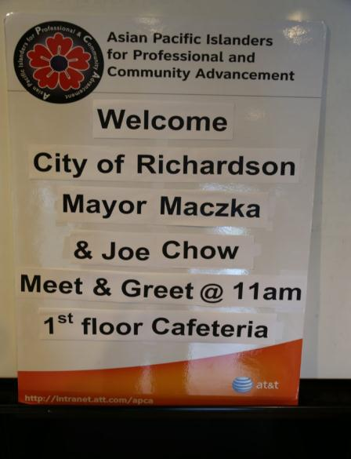
APCA Awareness Day
May 13th, 2014

Slide 6
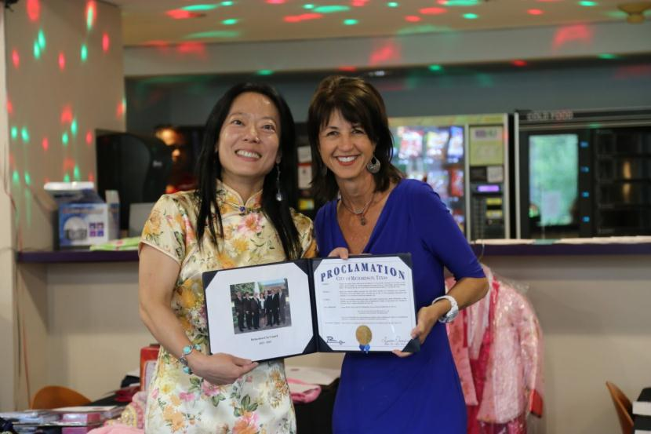
Richardson Mayor Laura Maczka Presenting Proclamation for
APCA Awareness Day @ AT&T Richardson Campbell Glen

Slide 7
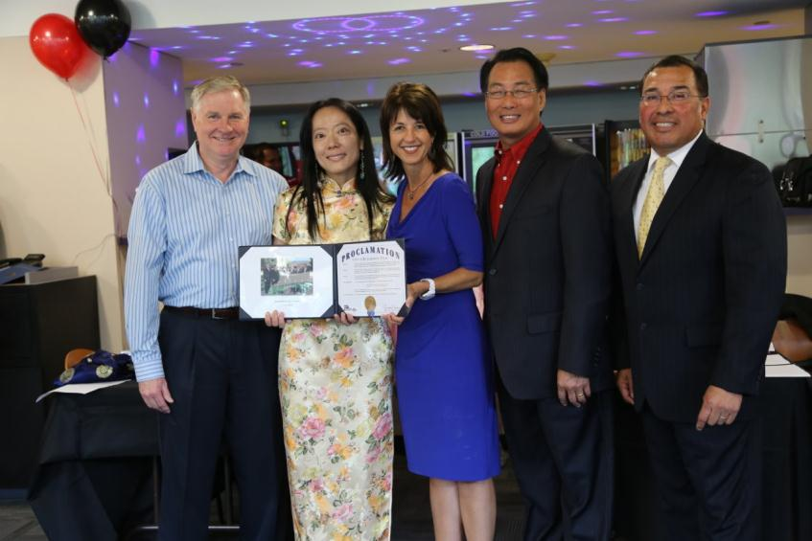
Rick Moss – AVP/M&HS, Jessica Yang – VP/APCA DFW, Laura Maczka/Richardson Mayor Joe Chow/Former Addison Mayor, Fred Maldonado Director/External Affairs

Slide 8
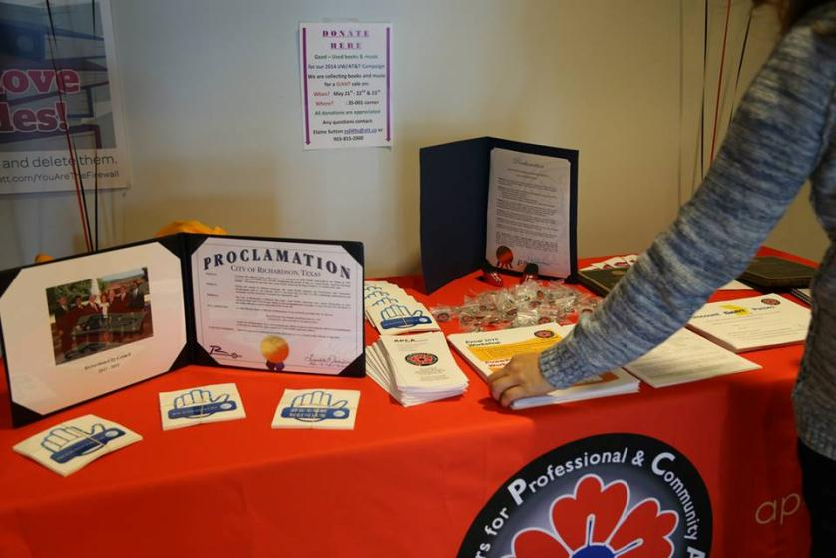
APCA Awareness Day – Meet & Greet

Slide 9
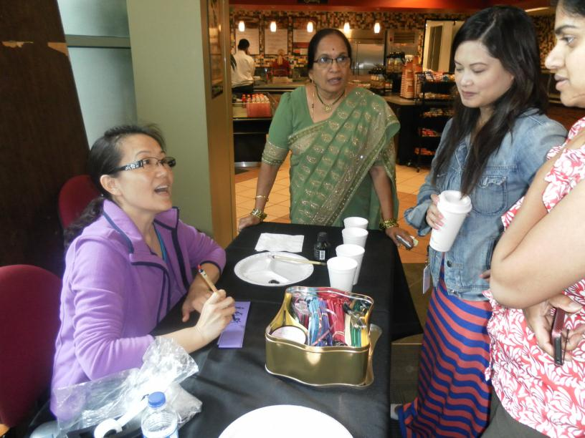
Tracy Pi Manning the Calligraphy Station

Slide 10
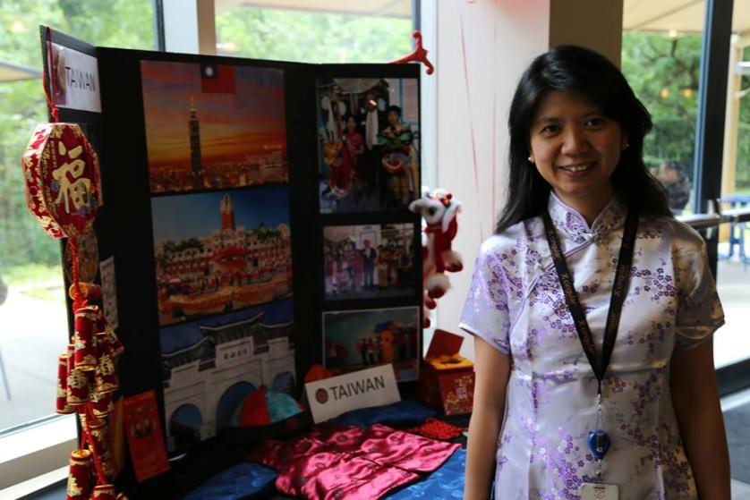
Beryl Wong @ Taiwan Booth

Slide 11
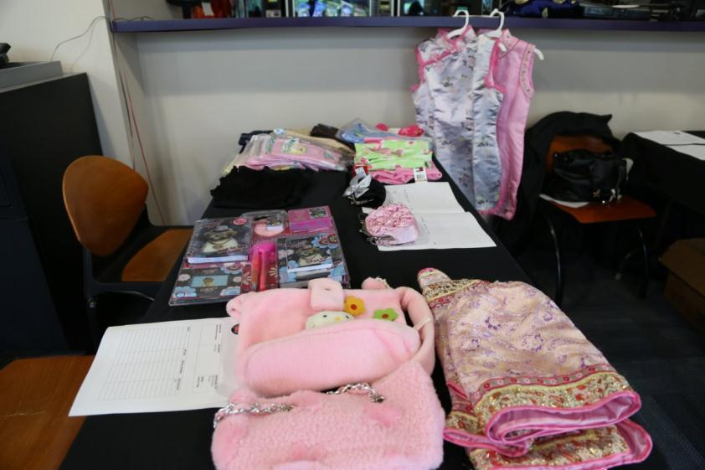
Silent Auction Booth Benefiting APCA Scholarship Program

Slide 12
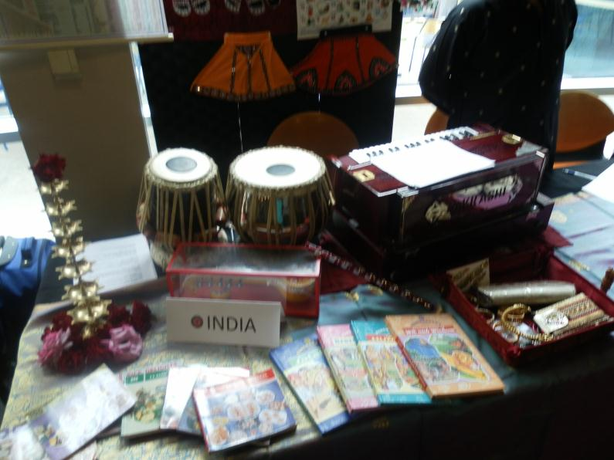
Around the Globe – India Booth

Slide 13
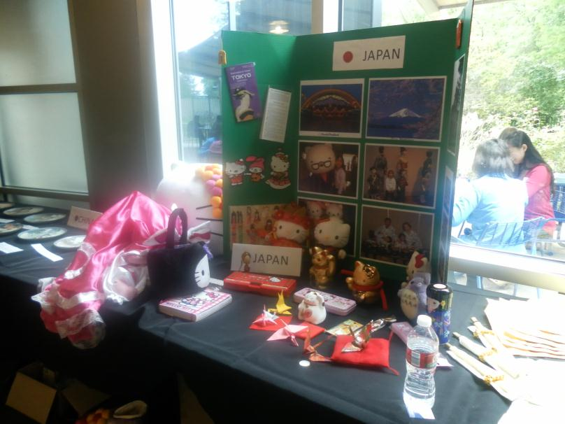
Around the Globe – Japan Booth

Slide 14
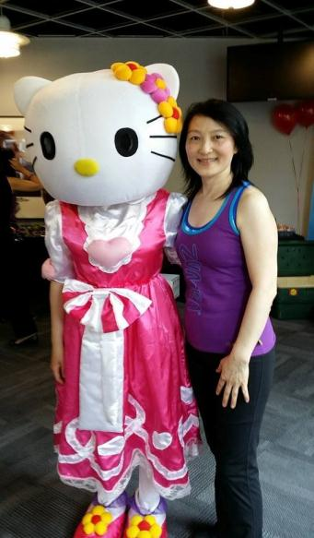
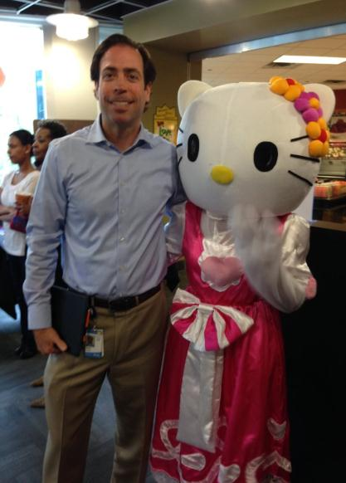
Lisha Yang and Aaron Baldwin with Hello Kitty

Slide 15
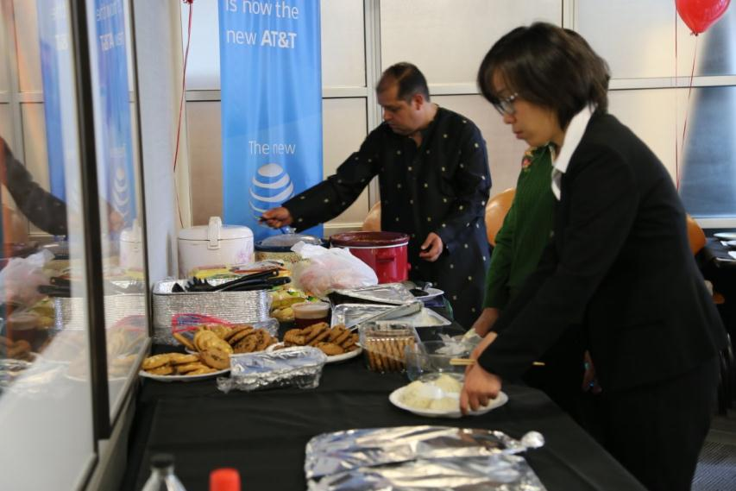
Lunch provided by APCA Volunteers for
APCA Scholarship Fundraising

Slide 16
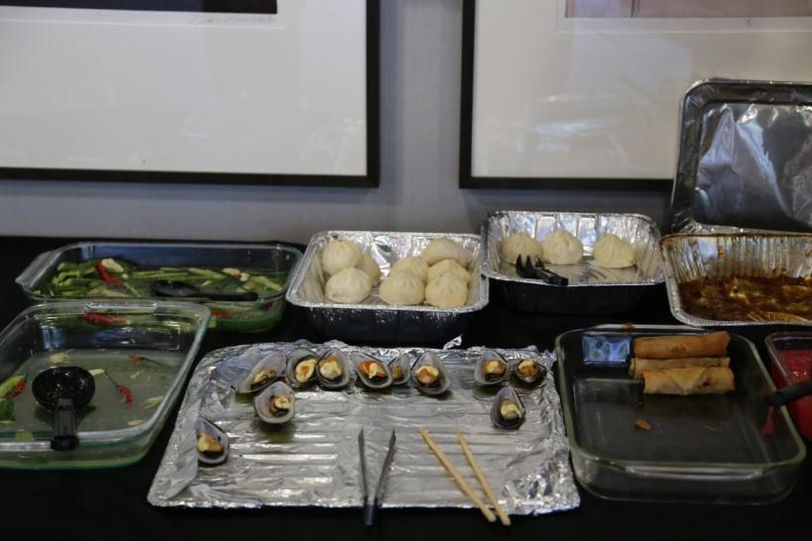
Lunch provided by APCA Volunteers for
APCA Scholarship Fundraising

Slide 17
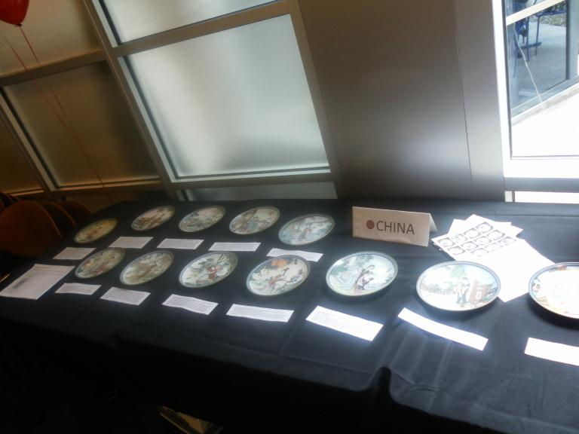
Precious Plate Collection shared by
APCA Member Dorothy Marshall

Slide 18
APCA Awareness Day Performances Connecting APCA to the Community

Slide 19
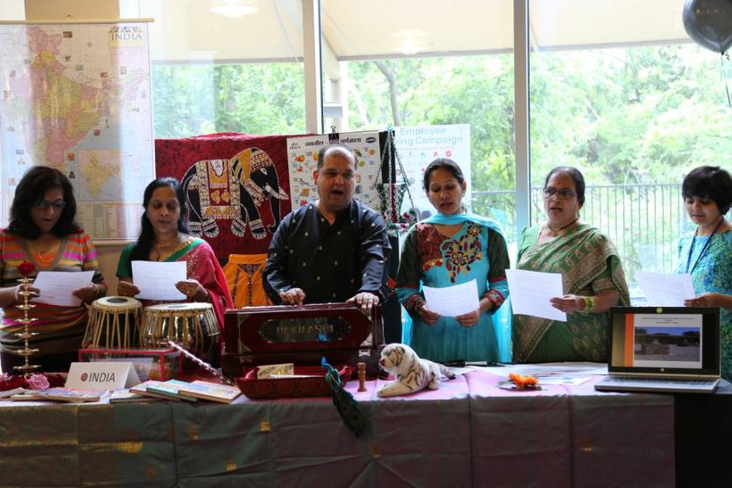
Indian Folk Song Performance with instrument – Harmonium

Slide 20
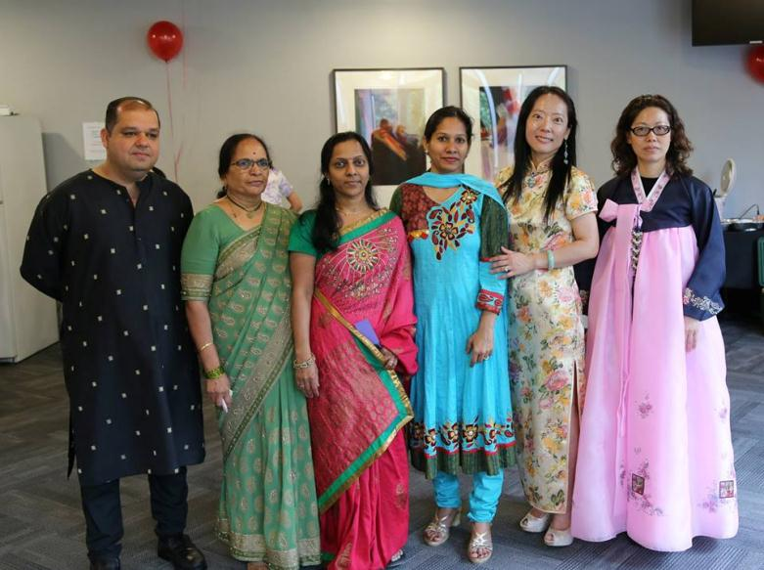
Best Dressed Contest – Best Dressed Male Winner Anand Amarnani, Nalini Totloor
Mallika Kopparapu, Madhuri Bondada, Jessica Yang, Female Winner Alice Au

Slide 21
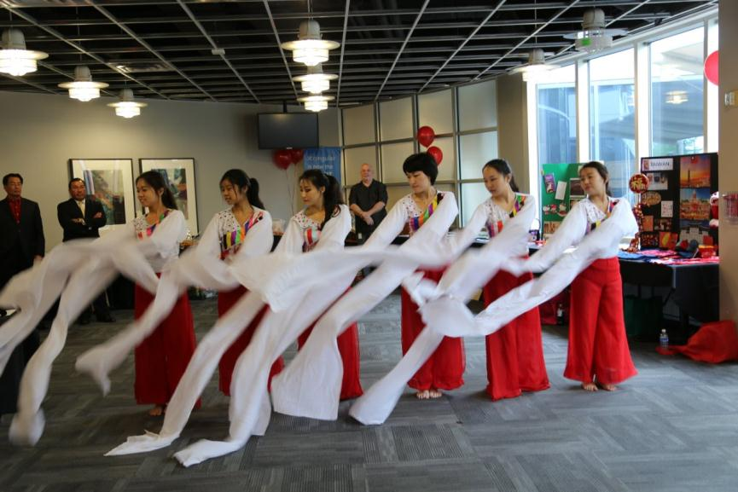
UTD International Talent Show Winning Team

Slide 22
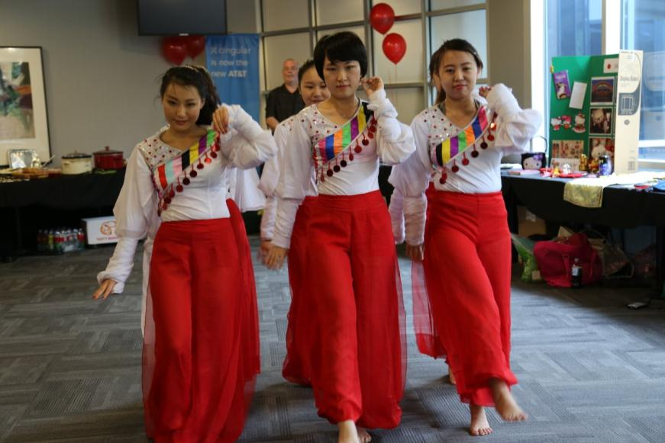
Artistic UTD Chinese Dance Performance

Slide 23
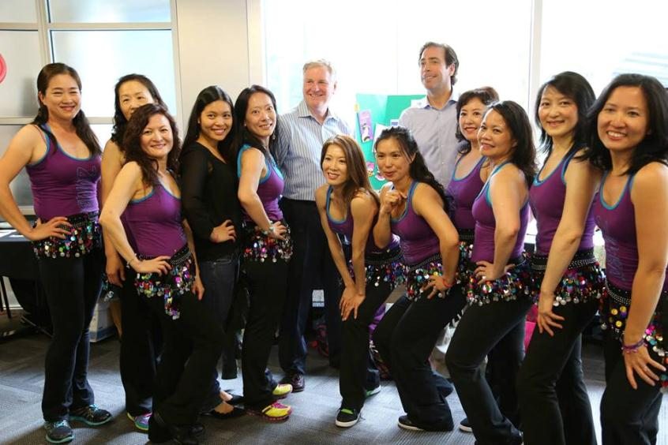
The quotation marks are not live type. They are images that can be moved. The quotation marks are not live type. They are images that can be moved. The quotation marks are not live type. They are images that can be moved.
Zumba Cardio Dance Performance Cindy Ji, Tracy Pi, Amy Chang, Tram Ngo, Jessica Yang
Rick Moss, Paula Cheung, Angie Lee, Aaron Baldwin, Sherry Yao, Liza Engh,
Lisha Yang and Carole Tam

Slide 24
The quotation marks are not live type. They are images that can be moved. The quotation marks are not live type. They are images that can be moved. The quotation marks are not live type. They are images that can be moved.
Zumba Instructor (Zin) Tracy Pi, Carole Tam, Amy Chang, Lead Zin Paula Cheung, Mayor Maczka, Zin Angie Lee, Lisha Yang, Sherry Yao, Zin Liza Engh

Slide 25
APCA Volunteers Kudos for a job well done

Slide 26
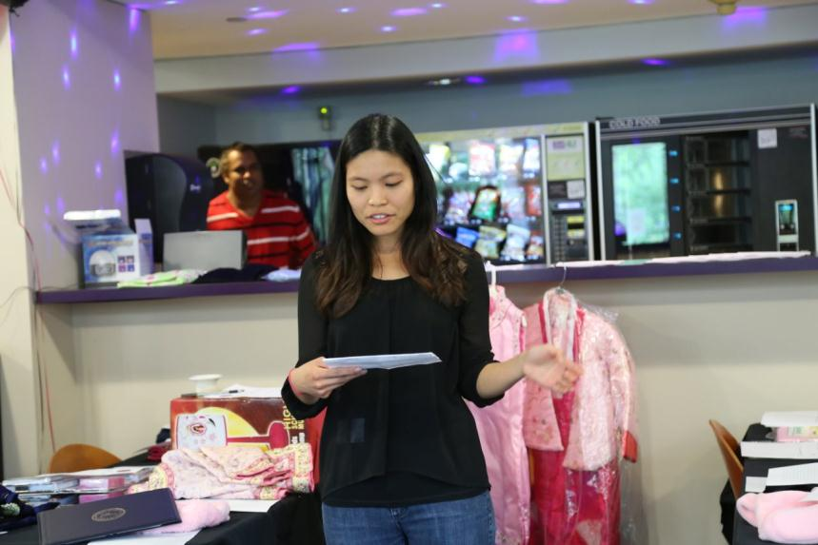
The quotation marks are not live type. They are images that can be moved. The quotation marks are not live type. They are images that can be moved. The quotation marks are not live type. They are images that can be moved.
Master of Ceremony Tram Ngo

Slide 27
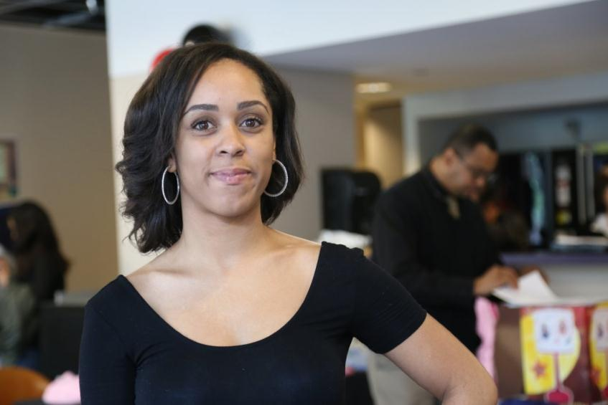
The quotation marks are not live type. They are images that can be moved. The quotation marks are not live type. They are images that can be moved. The quotation marks are not live type. They are images that can be moved.
Vanessa Glenn

Slide 28
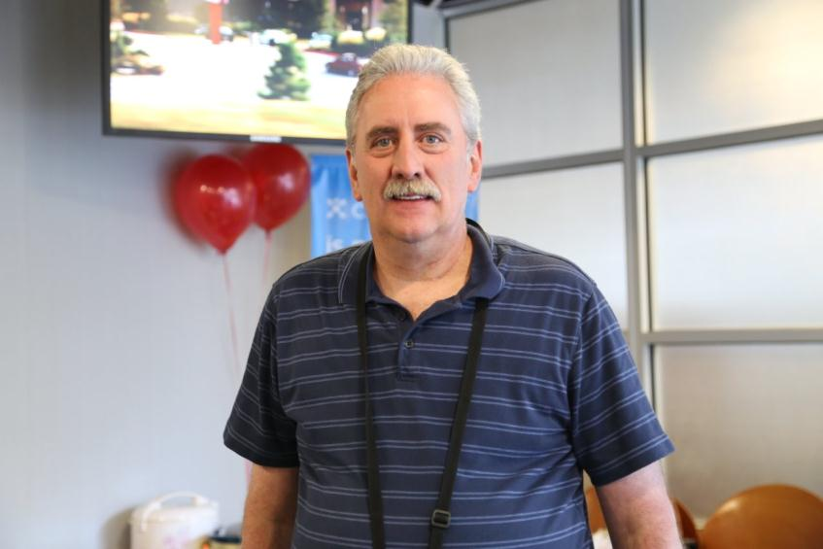
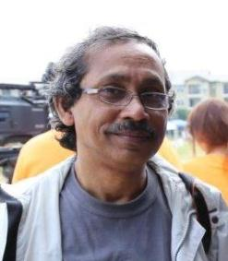
The quotation marks are not live type. They are images that can be moved. The quotation marks are not live type. They are images that can be moved. The quotation marks are not live type. They are images that can be moved.
Tim Blystone – Communication Officer
& Photographer Muhammad Haider

Slide 29
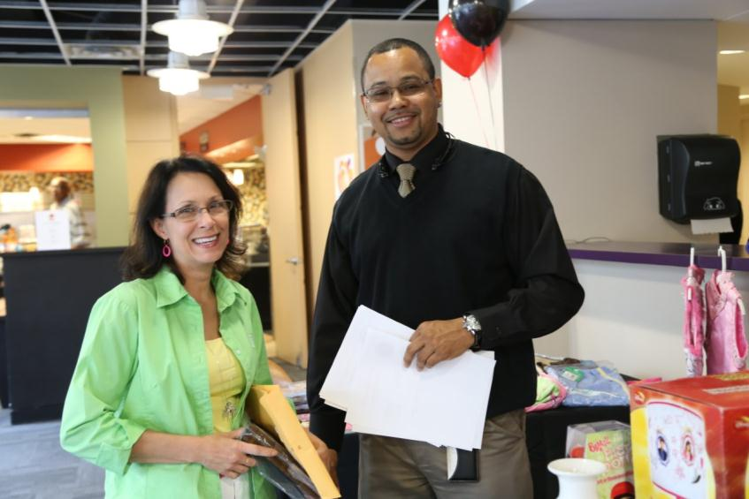
The quotation marks are not live type. They are images that can be moved. The quotation marks are not live type. They are images that can be moved. The quotation marks are not live type. They are images that can be moved.
Daphne Hartzog, Theodore Williams
Manning Membership & Silent Auction Booth

Slide 30
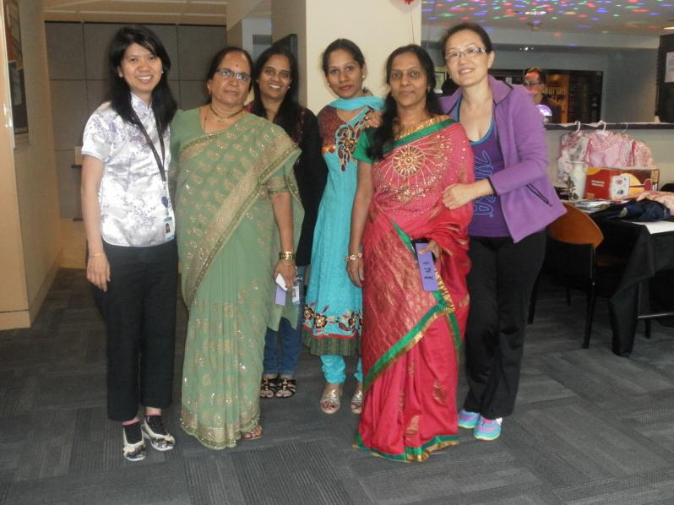
The quotation marks are not live type. They are images that can be moved. The quotation marks are not live type. They are images that can be moved. The quotation marks are not live type. They are images that can be moved.
Beryl Wong, Nalini Totloor, Madhuri Bondada,
Mallika Kopparapu, and Tracy Pi

Slide 31
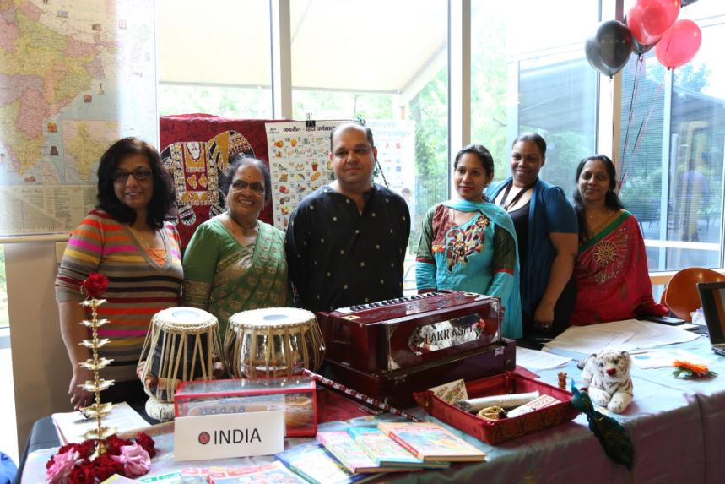
The quotation marks are not live type. They are images that can be moved. The quotation marks are not live type. They are images that can be moved. The quotation marks are not live type. They are images that can be moved.
Vijay Bhardwaj, Nalini Totloor, Anand Amarnani,
Madhuri Bondada, Angela Scott, Mallika Kopparapu

Slide 32
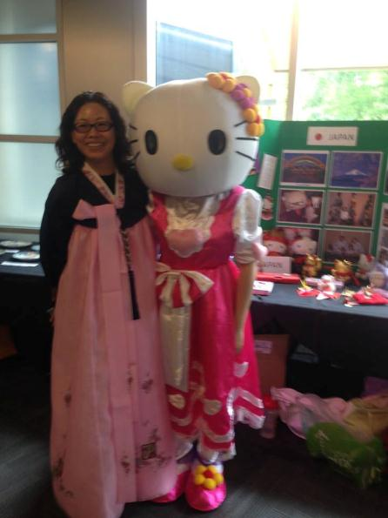
New APCA Member Alice Au & Hello Kitty – Lani Ma

Slide 33
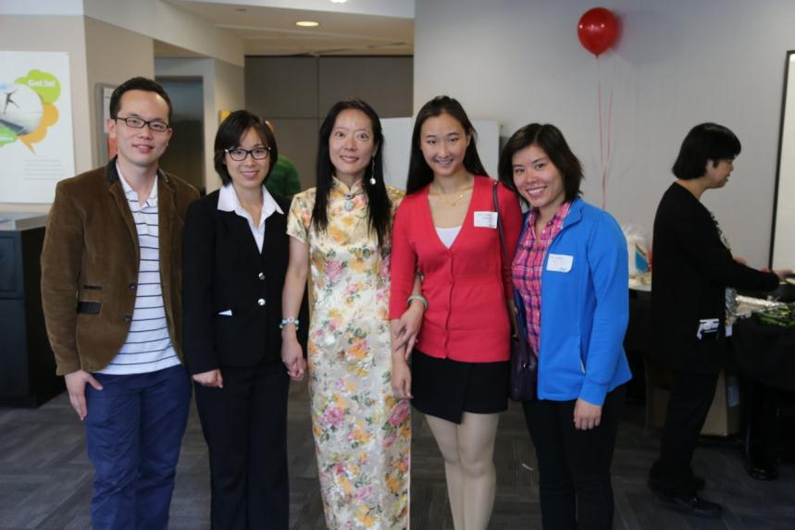
The quotation marks are not live type. They are images that can be moved. The quotation marks are not live type. They are images that can be moved. The quotation marks are not live type. They are images that can be moved.
UTD Student Volunteers, Jessica Yang, Amy Chou (far right)

Slide 34
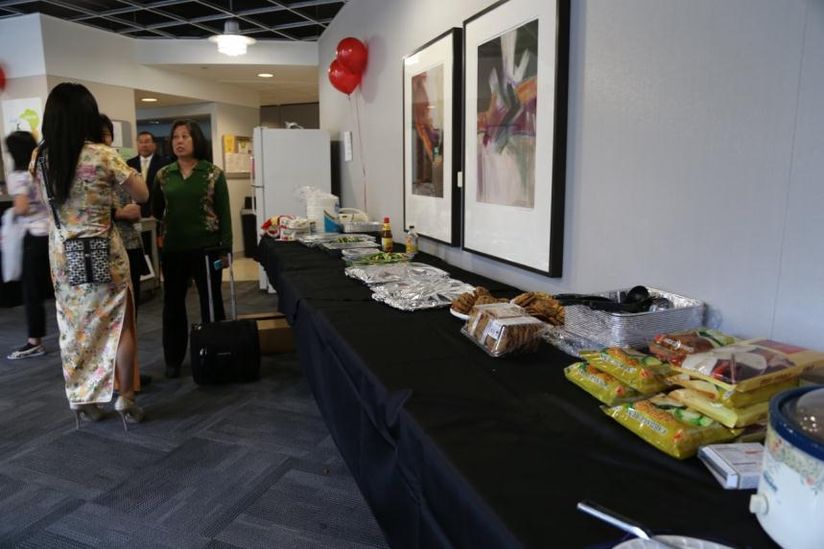
The quotation marks are not live type. They are images that can be moved. The quotation marks are not live type. They are images that can be moved. The quotation marks are not live type. They are images that can be moved.
Lining Wang Manning the Lunch Booth

